Slide 1


Decision Tree Learning
09
PART III · SUPERVISED LEARNING ALGORITHMS
CHAPTER 9 · WEEK 8
Machine Learning — From Hypotheses to Decisions
LECTURER
Dr. Mustafa Hameed
THE ISLAMIA UNIVERSITY OF BAHAWALPUR
Bahawalpur, Pakistan
Department of Information Technology · BSIT · Fall 2026
Notes:
Chapter 9: Decision Tree Learning. Part 3 — Supervised Learning Algorithms. Week 8: Decision trees. Handout pages 68–74.

Slide 2

Where this chapter sits
THE COURSE
PART I
PART II
PART III
PART IV
PART V
PART VI
1
2
3
4
5
6
7
8
9
10
11
12
13
14
15
16
17
18
19
20
21
22
Decision Tree Learning
BUILDS ON
USED LATER IN
Ch 2 Mathematics for Machine Learning
Ch 10 Bayesian Learning and Naive Bayes
Ch 4 Concept Learning and the Version Space
Ch 14 Ensemble Learning
Ch 7 Overfitting, Bias–Variance and Regularisation
Ch 21 Responsible and Ethical Machine Learning
Machine Learning · Chapter 9 · Decision Tree Learning
Handout p. 68 2
Notes:
Place the chapter. Before you start: Chapter 2 (entropy), Chapter 4 (hypothesis spaces and inductive bias) and Chapter 7 (overfitting, noise, choosing a setting by cross-validation).

Slide 3

What you will be able to do
LEARNING OUTCOMES
By the end of this chapter you will be able to:
1
Classify an example with a decision tree, and read a tree as a set of rules.
2
Compute entropy and information gain, and trace ID3’s choice of attribute at each node by hand.
3
Handle continuous attributes, attributes with many values (gain ratio) and the Gini index.
4
Explain why trees overfit noisy data, and apply reduced-error, rule post-pruning and cost-complexity pruning.
5
State the inductive bias of ID3.
Machine Learning · Chapter 9 · Decision Tree Learning
Handout p. 68 3
Notes:
Read these out: they are the chapter's contract with the room. Each click adds one.

Slide 4

Vocabulary for this chapter
KEY TERMS
decision tree
internal node, branch, leaf
ID3
entropy
information gain
split information
gain ratio
Gini index
CART
threshold split
overfitting
pre-pruning
reduced-error pruning
rule post-pruning
cost-complexity pruning
Occam’s razor
Each term is defined where it first matters — not here.
Machine Learning · Chapter 9 · Decision Tree Learning
Handout p. 68 4
Notes:
Do not define these now; they arrive one at a time. This slide is for the students' notes. Terms: decision tree; internal node, branch, leaf; ID3; entropy; information gain; split information; gain ratio; Gini index; CART; threshold split; overfitting; pre-pruning; reduced-error pruning; rule post-pruning; cost-complexity pruning; Occam’s razor.

Slide 5
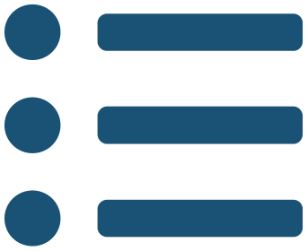
In this chapter
IN THIS CHAPTER
9.1
Trees as Hypotheses
p. 68 ›
9.2
Choosing the Question: Entropy and Information Gain
p. 69 ›
9.3
Beyond the Basic Algorithm
p. 70 ›
9.4
Overfitting, Noisy Data and Pruning
p. 71 ›
9.5
The Inductive Bias of ID3
p. 72 ›
Machine Learning · Chapter 9 · Decision Tree Learning
Handout pp. 68–74 5
Notes:
The route through the chapter. Each row is a link: click it to jump to that section in the slide show.

Slide 6
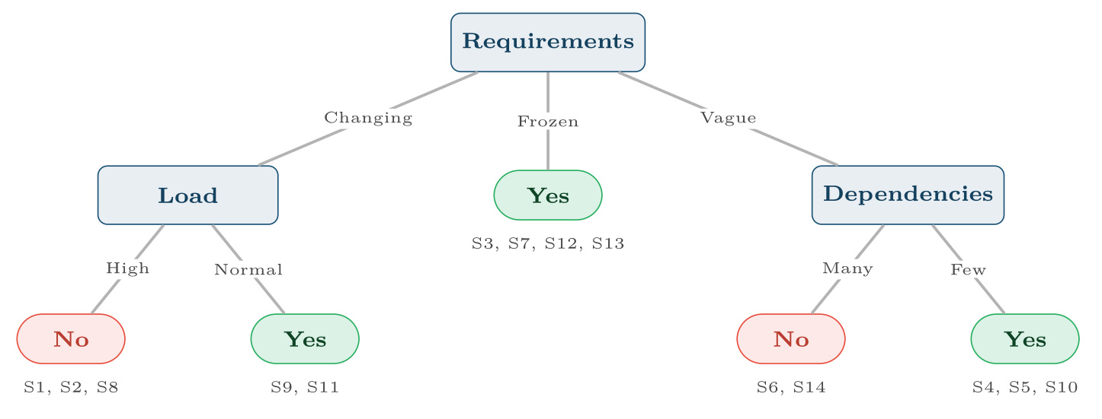
The tree ID3 learns from the fourteen past sprints
FIGURE 9.1
Under each leaf are the training sprints that reach it; every leaf is pure. It is equivalent to the rule: the goal is met if (requirements Changing and load Normal) or requirements Frozen or (requirements Vague and Few dependencies).
Machine Learning · Chapter 9 · Decision Tree Learning
§9.1 · Handout p. 68 6
Notes:
A decision tree classifies an example by asking a sequence of questions about its attributes. Each internal node tests one attribute, each branch is one outcome of the test, and each leaf gives a class. To classify, start at the root and follow the branches that match the example until a leaf is reached.
Figure 9.1 (handout p. 68): The tree ID3 learns from the fourteen past sprints. Under each leaf are the training sprints that reach it; every leaf is pure. It is equivalent to the rule: the goal is met if (requirements Changing and load Normal) or requirements Frozen or (requirements Vague and Few dependencies).

Slide 7
Choosing the Question: Entropy and Information Gain
SECTION 2 OF 5
9.2
9.1 Trees as Hypotheses
9.2 Choosing the Question: Entropy and Information Gain
9.3 Beyond the Basic Algorithm
9.4 Overfitting, Noisy Data and Pruning
9.5 The Inductive Bias of ID3
Machine Learning · Chapter 9
Handout §9.2 7
Notes:
Pause. Name the question this section answers.

Slide 8

Choosing the Question: Entropy and Information Gain
AT A GLANCE
Sprint | Requirements | Pressure | Load | Dependencies | Goal met
S1 | Changing | High | High | Few | No
S2 | Changing | High | High | Many | No
S3 | Frozen | High | High | Few | Yes
S4 | Vague | Medium | High | Few | Yes
S5 | Vague | Low | Normal | Few | Yes
S6 | Vague | Low | Normal | Many | No
S7 | Frozen | Low | Normal | Many | Yes
S8 | Changing | Medium | High | Few | No
S9 | Changing | Low | Normal | Few | Yes
S10 | Vague | Medium | Normal | Few | Yes
S11 | Changing | Medium | Normal | Many | Yes
S12 | Frozen | Medium | High | Many | Yes
Machine Learning · Chapter 9 · Decision Tree Learning
§9.2 · Handout p. 69 8
Notes:
A tree is a disjunction of conjunctions: each root-to-leaf path is an AND of tests, and the tree is the OR of the paths that end in “Yes”. That makes trees far more expressive than the conjunctions of Chapter 4 — a large enough tree can represent any discrete function — and it makes them readable. Trees suit problems where examples are attribute–value pairs, the target is discrete, disjunctions may be needed, and the training data may contain errors or missing values. Fourteen past sprints, each described by four attributes, and whether the sprint met its goal. Requirements were Changing, Frozen or Vague during the sprint; Pressure is the deadline pressure; Load is whether the team was carrying more work than usual; Dependencies counts waits on other teams. (This is Mitchell’s PlayTennis table with the attributes renamed, so every number below can be checked against the set text.)

Slide 9
Choosing the Question: Entropy and Information Gain (continued)
AT A GLANCE
Sprint | Requirements | Pressure | Load | Dependencies | Goal met
S13 | Frozen | High | Normal | Few | Yes
S14 | Vague | Medium | High | Many | No
Machine Learning · Chapter 9 · Decision Tree Learning
§9.2 · Handout p. 69 9
Notes:
Do not read the table row by row: pick the row the room is most likely to get wrong and ask why.

Slide 10

Information Gain
DEFINITION
The information gain of attribute A on example set S is the expected reduction in entropy from splitting S on A:
where S_{v} is the subset of S with A = v. ID3 puts the attribute with the highest gain at the node.
Machine Learning · Chapter 9 · Decision Tree Learning
§9.2 · Handout p. 69 10
Notes:
ID3 grows the tree top-down and greedily: at each node, it asks which single attribute best separates the examples that reach it, puts that attribute there, and recurses on each branch. “Best separates” is measured with the entropy of Chapter 2.

Slide 11
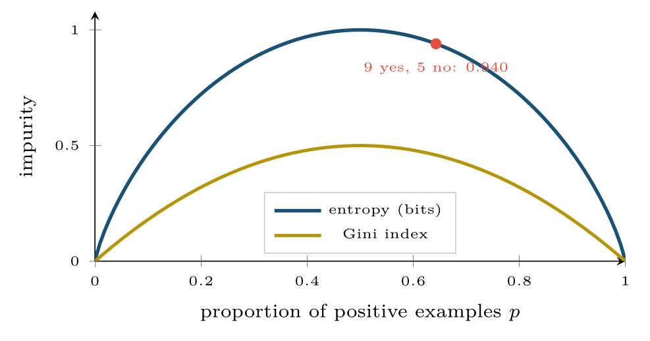
Two impurity measures for a two-class node
FIGURE 9.2
Both are zero for a pure node and largest for an even split; they almost always pick the same attribute.
Machine Learning · Chapter 9 · Decision Tree Learning
§9.2 · Handout p. 69 11
Notes:
Figure 9.2 (handout p. 70): Two impurity measures for a two-class node. Both are zero for a pure node and largest for an even split; they almost always pick the same attribute.

Slide 12

ID3’s First Choice on the Sprint Data
WORKED EXAMPLE
The root. 9 Yes, 5 No: Entropy(S) = 0.940 (computed in Chapter 2).
Requirements splits S into Changing (2 Yes, 3 No: entropy 0.971), Frozen (4, 0: entropy 0) and Vague (3, 2: entropy 0.971):
Load: High (3, 4: 0.985), Normal (6, 1: 0.592):
Dependencies: Few (6, 2: 0.811), Many (3, 3: 1.000):
Pressure: Gain = 0.029 (check it yourself).
Machine Learning · Chapter 9 · Decision Tree Learning
§9.2 · Handout p. 69 12
Notes:
Each click adds one step of the working. Ask for the next number before you reveal it.

Slide 13
ID3’s First Choice on the Sprint Data (continued)
WORKED EXAMPLE
Requirements wins and goes at the root. Its Frozen branch is already pure, so it becomes a Yes leaf.
The Changing branch (S1, S2, S8, S9, S11; entropy 0.971) is split the same way, using only those five sprints: Gain(Load) = 0.971, Gain(Pressure) = 0.571, Gain(Dependencies) = 0.020. Load separates them perfectly. On the Vague branch Dependencies does the same. Every leaf is now pure, and ID3 stops with the tree of Figure 9.1.
Machine Learning · Chapter 9 · Decision Tree Learning
§9.2 · Handout p. 69 13
Notes:
Each click adds one step of the working. Ask for the next number before you reveal it.

Slide 14
Choosing a Threshold
WORKED EXAMPLE
Six sprints in which 40, 48, 60, 72, 80, 90 per cent of the stories had been refined (given acceptance criteria) before the sprint began, and the goal was met No, No, Yes, Yes, Yes, No. The class changes between 48 and 60 and between 80 and 90, so the candidates are t = 54 and t = 85. The set has 3 Yes and 3 No: entropy 1.
• t = 54: ≤ 54 holds {No, No} (entropy 0); > 54 holds 3 Yes, 1 No (entropy 0.811). Gain = 1 − 4/6(0.811) = 0.459.
• t = 85: ≤ 85 holds 3 Yes, 2 No (0.971); > 85 holds {No} (0). Gain = 1 − 5/6(0.971) = 0.191.
The test Refined ≤ 54 is chosen.
Machine Learning · Chapter 9 · Decision Tree Learning
§9.3 · Handout p. 70 14
Notes:
Continuous attributes. A numeric attribute is turned into a yes/no test A ≤ t. The only thresholds worth trying are midpoints between adjacent sorted values where the class changes; each is scored by information gain like any other attribute.
Each click adds one step of the working. Ask for the next number before you reveal it.

Slide 15
Beyond the Basic Algorithm
IN BRIEF
Attributes with many values. Information gain favours attributes with many values. An attribute such as SprintID splits the training sprints into fourteen pure singletons — maximal gain, zero use. C4.5 corrects this with the gain ratio, dividing the gain by the split information, the entropy of the split itself:
Machine Learning · Chapter 9 · Decision Tree Learning
§9.3 · Handout p. 70 15
Notes:
Attributes with many values. Information gain favours attributes with many values. An attribute such as SprintID splits the training sprints into fourteen pure singletons — maximal gain, zero use. C4.5 corrects this with the gain ratio, dividing the gain by the split information, the entropy of the split itself:

Slide 16
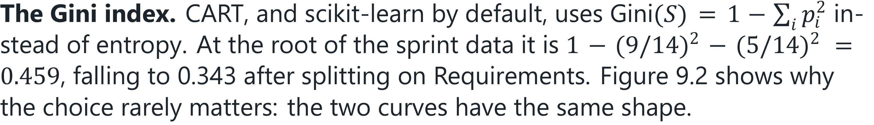
Beyond the Basic Algorithm
IN BRIEF
For Requirements (5, 4, 5 sprints) SplitInfo = 1.577 and the gain ratio is 0.246/1.577 = 0.156. For SprintID, SplitInfo = log₂ 14 = 3.81, which heavily discounts its gain.
Machine Learning · Chapter 9 · Decision Tree Learning
§9.3 · Handout p. 70 16
Notes:
For Requirements (5, 4, 5 sprints) SplitInfo = 1.577 and the gain ratio is 0.246/1.577 = 0.156. For SprintID, SplitInfo = log2 14 = 3.81, which heavily discounts its gain.

Slide 17
Overfitting, Noisy Data and Pruning
SECTION 4 OF 5
9.4
9.1 Trees as Hypotheses
9.2 Choosing the Question: Entropy and Information Gain
9.3 Beyond the Basic Algorithm
9.4 Overfitting, Noisy Data and Pruning
9.5 The Inductive Bias of ID3
Machine Learning · Chapter 9
Handout §9.4 17
Notes:
Pause. Name the question this section answers.

Slide 18
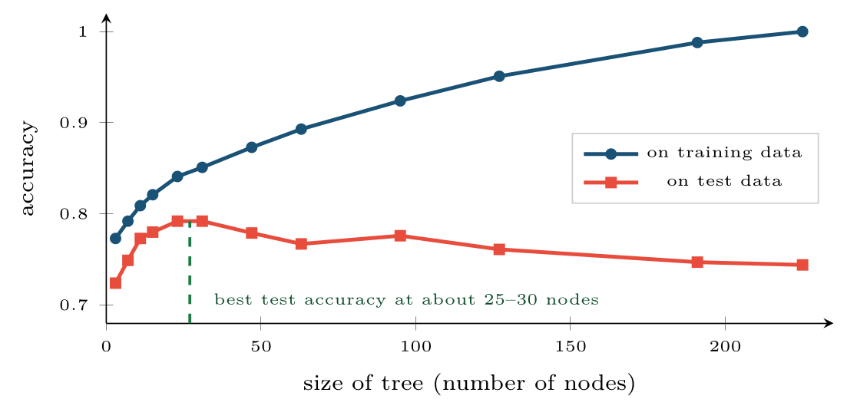
Accuracy against tree size on data with 15% label noise
FIGURE 9.3
Training accuracy climbs to 100% as the tree memorises the noise; test accuracy peaks early and then declines.
Machine Learning · Chapter 9 · Decision Tree Learning
§9.4 · Handout p. 71 18
Notes:
Missing values. An example missing the tested attribute can be sent down the most common branch, or split fractionally among all branches in proportion to their training frequencies (C4.5’s approach). ID3 keeps splitting until every leaf is pure. With noisy data that means growing branches whose only purpose is to fit the mislabelled examples: add one wrongly recorded sprint — (Changing, High, Normal, Many, No) — and ID3 must grow a new subtree under Changing/Normal just to isolate it. Figure 9.3 shows the effect on a dataset in which 15% of the labels were flipped.
Figure 9.3 (handout p. 71): Accuracy against tree size on data with 15% label noise. Training accuracy climbs to 100% as the tree memorises the noise; test accuracy peaks early and then declines.

Slide 19
Pruning
DEFINITION
Pre-pruning stops growth early: a maximum depth, a minimum number of examples per leaf, or a minimum gain. Post-pruning grows the full tree and then cuts it back:
• Reduced-error pruning: using a separate validation set, repeatedly replace the subtree whose removal most improves validation accuracy by a leaf labelled with its majority class; stop when every removal hurts.
• Rule post-pruning (C4.5): convert the tree into one rule per root-to-leaf path, drop any precondition whose removal does not hurt the rule’s estimated accuracy, and sort the rules by accuracy.
• Cost-complexity pruning (CART): minimise error + α × (number of leaves); larger α gives smaller trees, and α is chosen by cross-validation.
Machine Learning · Chapter 9 · Decision Tree Learning
§9.4 · Handout p. 71 19
Notes:
Read the box aloud, then ask for an example from the room before moving on.

Slide 20

Why Rules Are Easier to Prune Than Trees
CONCEPT
Pruning a tree removes a node and everything below it — a decision about the root’s test affects every path through it. Converting to rules first lets each path be simplified on its own: the test Requirements = Changing can be dropped from one rule and kept in another. It also produces a list of plain if–then statements, which is what a project manager actually wants to read — and can turn straight into a risk checklist.
Machine Learning · Chapter 9 · Decision Tree Learning
§9.4 · Handout p. 71 20
Notes:
Read the box aloud, then ask for an example from the room before moving on.

Slide 21

Common pitfalls
COMMON PITFALLS
✕
Letting the tree grow until the leaves are pure on noisy data. It will fit the noise; prune, or cap the depth.
✕
Keeping an ID-like attribute. It has maximal information gain and no predictive value. Drop it, or use the gain ratio.
✕
Reading the root attribute as “the most important feature”. Greedy splitting on correlated features picks one almost arbitrarily.
✕
Expecting stability. A small change in the data can change the root and hence the whole tree — the high variance that Chapter 14 exploits.
✕
Scaling features for a tree. Unnecessary: a threshold test is unchanged by any monotone rescaling.
Machine Learning · Chapter 9 · Decision Tree Learning
§9.5 · Handout p. 72 21
Notes:
For each pitfall, ask who has seen it happen. One real story beats five bullets.

Slide 22

Try it yourself: ID3 by Hand, Then Pruning by Cross-Validation
TRY IT YOURSELF
WHAT YOU WILL DO
1. ID3's first choice, computed by hand
2. Noisy data: a tree grown without limit, then pruned
THIS WEEK'S LAB
WHAT YOU WILL RUN
RUNNABLE COPY
Week 8: ID3 by hand, pruning by cross-validation
1 listing, 57 lines of Python
code/ch09_id3_hand_pruning_cross.py
Machine Learning · Chapter 9 · Decision Tree Learning
§9.5 · Handout p. 72 22
Notes:
Say what the room will have at the end of the lab, then let them start. Circulate rather than lecture.

Slide 23
ID3 by Hand, Then Pruning by Cross-Validation
LAB · STEP 1 OF 5
Set-up
Python · code/ch09_id3_hand_pruning_cross.py
2
3
4
5
6
import numpy as np
import pandas as pd
from sklearn.datasets import make_classification
from sklearn.model_selection import train_test_split, cross_val_score
from sklearn.tree import DecisionTreeClassifier, export_text
Machine Learning · Chapter 9 · Decision Tree Learning
§9.5 · Handout p. 72 23
Notes:
Step 1: Set-up. Read the code aloud; ask what each line would print before running it.

Slide 24
ID3 by Hand, Then Pruning by Cross-Validation
LAB · STEP 2 OF 5
ID3's first choice, computed by hand
Python · code/ch09_id3_hand_pruning_cross.py
8
9
10
11
12
13
14
15
16
17
18
19
20
21
22
# --- 1. ID3's first choice, computed by hand -----------------------------
rows = ["Changing High High Few No", "Changing High High Many No",
"Frozen High High Few Yes", "Vague Medium High Few Yes",
"Vague Low Normal Few Yes", "Vague Low Normal Many No",
"Frozen Low Normal Many Yes", "Changing Medium High Few No",
"Changing Low Normal Few Yes", "Vague Medium Normal Few Yes",
"Changing Medium Normal Many Yes", "Frozen Medium High Many Yes",
"Frozen High Normal Few Yes", "Vague Medium High Many No"]
df = pd.DataFrame([r.split() for r in rows],
columns=["Reqs", "Pressure", "Load", "Deps", "Met"])
def entropy(labels):
p = labels.value_counts(normalize=True)
return float(-(p * np.log2(p)).sum())
Machine Learning · Chapter 9 · Decision Tree Learning
§9.5 · Handout p. 72 24
Notes:
Step 2: ID3's first choice, computed by hand. Read the code aloud; ask what each line would print before running it.

Slide 25
ID3 by Hand, Then Pruning by Cross-Validation
LAB · STEP 3 OF 5
ID3's first choice, computed by hand (continued)
Python · code/ch09_id3_hand_pruning_cross.py
25
26
27
28
29
30
31
32
33
34
35
def gain(data, attr):
rest = sum(len(g) / len(data) * entropy(g.Met)
for _, g in data.groupby(attr))
return entropy(data.Met) - rest
for a in ["Reqs", "Pressure", "Load", "Deps"]:
print(f"Gain(S, {a:8s}) = {gain(df, a):.3f}")
changing = df[df.Reqs == "Changing"]
print("inside Changing:", {a: round(gain(changing, a), 3)
for a in ["Pressure", "Load", "Deps"]})
Machine Learning · Chapter 9 · Decision Tree Learning
§9.5 · Handout p. 72 25
Notes:
Step 3: ID3's first choice, computed by hand (continued). Read the code aloud; ask what each line would print before running it.

Slide 26
ID3 by Hand, Then Pruning by Cross-Validation
LAB · STEP 4 OF 5
Noisy data: a tree grown without limit, then pruned
Python · code/ch09_id3_hand_pruning_cross.py
37
38
39
40
41
42
43
44
45
46
# --- 2. noisy data: a tree grown without limit, then pruned -------------
X, y = make_classification(n_samples=1500, n_features=10, n_informative=4,
flip_y=0.15, random_state=4) # 15% labels flipped
X_tr, X_te, y_tr, y_te = train_test_split(X, y, test_size=0.5,
random_state=0)
full = DecisionTreeClassifier(criterion="entropy", random_state=0)
full.fit(X_tr, y_tr)
print(f"unpruned: {full.tree_.node_count:3d} nodes, "
f"train {full.score(X_tr, y_tr):.3f}, "
f"test {full.score(X_te, y_te):.3f}")
Machine Learning · Chapter 9 · Decision Tree Learning
§9.5 · Handout p. 72 26
Notes:
Step 4: Noisy data: a tree grown without limit, then pruned. Read the code aloud; ask what each line would print before running it.

Slide 27
ID3 by Hand, Then Pruning by Cross-Validation
LAB · STEP 5 OF 5
Noisy data: a tree grown without limit, then pruned (continued)
Python · code/ch09_id3_hand_pruning_cross.py
48
49
50
51
52
53
54
55
56
57
58
# cost-complexity pruning: choose alpha by 5-fold CV on the training data
alphas = full.cost_complexity_pruning_path(X_tr, y_tr).ccp_alphas[:-1]
cv = [cross_val_score(DecisionTreeClassifier(criterion="entropy",
ccp_alpha=a, random_state=0), X_tr, y_tr, cv=5).mean() for a in alphas]
best = alphas[int(np.argmax(cv))]
pruned = DecisionTreeClassifier(criterion="entropy", ccp_alpha=best,
random_state=0).fit(X_tr, y_tr)
print(f"pruned: {pruned.tree_.node_count:3d} nodes, "
f"train {pruned.score(X_tr, y_tr):.3f}, "
f"test {pruned.score(X_te, y_te):.3f} (alpha = {best:.4f})")
print(export_text(pruned, max_depth=1))
Machine Learning · Chapter 9 · Decision Tree Learning
§9.5 · Handout p. 72 27
Notes:
Step 5: Noisy data: a tree grown without limit, then pruned (continued). Read the code aloud; ask what each line would print before running it.

Slide 28
What the lab shows
TRY IT YOURSELF
Part 1 prints 0.247 for Requirements and 0.152 for Load where the worked example has 0.246 and 0.151: the code does not round the intermediate entropies. Part 2 stands in for 1,500 past sprints described by ten numeric features, 15% of them recorded with the wrong outcome. Pruning cuts the tree from 207 to 63 nodes and raises test accuracy from 0.72 to 0.75 while lowering training accuracy — the signature of removing overfitting.
Machine Learning · Chapter 9 · Decision Tree Learning
§9.5 · Handout p. 72 28
Notes:
Read the box aloud, then ask for an example from the room before moving on.

Slide 29

A node holds 8 positive and 8 negative examples. A test splits it into (6+, 2−) and (2+, 6−). Compute the information gain.
CHECKPOINT 1 OF 3
Discuss with the person next to you, then advance.
Machine Learning · Chapter 9 · Decision Tree Learning
Handout p. 74 · answers in Appendix D 29
Notes:
Ask the room. Do not advance until someone commits to an answer.

Slide 30

A node holds 8 positive and 8 negative examples. A test splits it into (6+, 2−) and (2+, 6−). Compute the information gain.
CHECKPOINT 1 OF 3 · ANSWER
The parent has entropy 1. Each child has entropy −0.75log₂ 0.75 − 0.25log₂ 0.25 = 0.811 and holds half the examples, so Gain = 1 − 0.811 = 0.189.
Machine Learning · Chapter 9 · Decision Tree Learning
Handout p. 74 · answers in Appendix D 30
Notes:
Answer (Appendix D): The parent has entropy 1. Each child has entropy −0.75log2 0.75 − 0.25log2 0.25 = 0.811 and holds half the examples, so Gain = 1 − 0.811 = 0.189.

Slide 31
Why does information gain favour an attribute such as TaskID? What fixes it?
CHECKPOINT 2 OF 3
Discuss with the person next to you, then advance.
Machine Learning · Chapter 9 · Decision Tree Learning
Handout p. 74 · answers in Appendix D 31
Notes:
Ask the room. Do not advance until someone commits to an answer.

Slide 32
Why does information gain favour an attribute such as TaskID? What fixes it?
CHECKPOINT 2 OF 3 · ANSWER
Every ID is unique, so splitting on it gives one pure leaf per task: maximum gain, no generalisation. Use the gain ratio, whose split-information term penalises many-valued attributes — or remove identifiers.
Machine Learning · Chapter 9 · Decision Tree Learning
Handout p. 74 · answers in Appendix D 32
Notes:
Answer (Appendix D): Every ID is unique, so splitting on it gives one pure leaf per task: maximum gain, no generalisation. Use the gain ratio, whose split-information term penalises many-valued attributes — or remove identifiers.

Slide 33
What is the difference between a restriction bias and a preference bias? Which does ID3 have?
CHECKPOINT 3 OF 3
Discuss with the person next to you, then advance.
Machine Learning · Chapter 9 · Decision Tree Learning
Handout p. 74 · answers in Appendix D 33
Notes:
Ask the room. Do not advance until someone commits to an answer.

Slide 34
What is the difference between a restriction bias and a preference bias? Which does ID3 have?
CHECKPOINT 3 OF 3 · ANSWER
A restriction bias limits which hypotheses can be represented (Candidate-Elimination’s conjunctions); a preference bias searches a complete space but prefers some hypotheses. ID3 has a preference bias: shorter trees, high-gain attributes near the root.
Machine Learning · Chapter 9 · Decision Tree Learning
Handout p. 74 · answers in Appendix D 34
Notes:
Answer (Appendix D): A restriction bias limits which hypotheses can be represented (Candidate-Elimination’s conjunctions); a preference bias searches a complete space but prefers some hypotheses. ID3 has a preference bias: shorter trees, high-gain attributes near the root.

Slide 35

What to take away
CHAPTER SUMMARY
1
A decision tree is a disjunction of conjunctions of attribute tests; it can represent any discrete function and reads as a set of rules.
2
ID3 grows the tree greedily, choosing at each node the attribute with the greatest information gain; on the sprint data, Requirements (0.246) wins at the root.
3
Numeric attributes become threshold tests at class boundaries; the gain ratio corrects the preference for many-valued attributes; Gini behaves like entropy.
4
Grown to purity on noisy data, trees overfit. Pre-prune with depth or leaf-size limits, or post-prune by reduced error, rules or cost complexity, choosing the strength by validation.
5
ID3’s inductive bias is a preference for short trees with high-gain attributes near the root — Occam’s razor.
Machine Learning · Chapter 9 · Decision Tree Learning
Handout p. 74 35
Notes:
Ask the room to say each takeaway before you reveal it.

Slide 36

Quick check 1 of 3
REVIEW · MULTIPLE CHOICE
The entropy of a node with 4 positive and 4 negative examples is:
A
0
B
0.5
C
1
D
2
Machine Learning · Chapter 9 · Decision Tree Learning
Handout p. 74 36
Notes:
Take a show of hands for each option before discussing. (The handout does not print MCQ answers.)

Slide 37
Quick check 2 of 3
REVIEW · MULTIPLE CHOICE
C4.5’s gain ratio divides information gain by:
A
the number of examples
B
the split information
C
the Gini index
D
the tree depth
Machine Learning · Chapter 9 · Decision Tree Learning
Handout p. 74 37
Notes:
Take a show of hands for each option before discussing. (The handout does not print MCQ answers.)

Slide 38
Quick check 3 of 3
REVIEW · MULTIPLE CHOICE
Cost-complexity pruning with a larger α gives:
A
a larger tree
B
a smaller tree
C
the same tree
D
a deeper tree
Machine Learning · Chapter 9 · Decision Tree Learning
Handout p. 74 38
Notes:
Take a show of hands for each option before discussing. (The handout does not print MCQ answers.)

Slide 39
For your notebook
REVIEW QUESTIONS
SHORT
Explain why a tree that classifies every training example correctly may be a poor model.
SHORT
Describe reduced-error pruning and state what data it requires.
SHORT
Why do decision trees not need feature scaling?
APPLIED
Compute Gain(S, Pressure) for the full sprint data, showing the entropy of each of the three branches.
APPLIED
On the Vague branch of the sprint data (S4, S5, S6, S10, S14), compute the gain of Load, Pressure and Dependencies, and confirm that ID3 chooses Dependencies.
Machine Learning · Chapter 9 · Decision Tree Learning
Handout p. 74 39
Notes:
Set these for independent study. Model answers are not printed in the handout.

Slide 40

The Inductive Bias of ID3
KEY IDEA
ID3 searches a complete hypothesis space — every discrete function is some tree — so, unlike Candidate-Elimination, it does not restrict what can be learned. Its bias lies in its search: it is greedy, never backtracks, and so prefers shorter trees and trees that put high-gain attributes near the root. That is a preference bias (an ordering over hypotheses), where Candidate-Elimination’s was a restriction bias (a limit on which hypotheses exist). Its justification is a form of Occam’s razor: there are far fewer short trees than long ones, so a short tree that fits the data is less likely to fit it by coincidence.
Machine Learning · Chapter 9 · Decision Tree Learning
§9.5 · Handout p. 72 40
Notes:
Say this in your own words first; the slide is the handout's wording.

Slide 41
End of Chapter 9
09
NEXT
READ
Chapter 10 — Bayesian Learning and Naive Bayes
Handout Chapter 9, pages 68–74
THIS WEEK'S LAB
ASSESSMENT
ID3 by hand, pruning by cross-validation
Midterm (Ch 1–8)
Machine Learning · Chapter 9 · Decision Tree Learning
41
Notes:
Close. NEXT: Chapter 10 — Bayesian Learning and Naive Bayes. READ: Handout Chapter 9, pages 68–74. THIS WEEK'S LAB: ID3 by hand, pruning by cross-validation. ASSESSMENT: Midterm (Ch 1–8).

